Slide 1
NYC Parking Ticket Data Analysis
By Rene Barillas, Ruben Becerra, Aaron Lopez, Brian Burwick, Erick Arevalo, Nazmul Khan

Slide 2
Agenda
Data information
Specifications
Workflow
Data Cleaning
Queries
Visual Analysis
Geo Spatial Visualization
Tempo-Spatial Visualization
Findings
References

Slide 3
Introduction
Since the city issues about 10M tickets per year, we decided to look at the data to see patterns by observing different fields. The analysis is important because we can see what causes the most tickets to be issued and where the hot zones for tickets are so people can avoid getting a ticket. After we analyze the data, we can determine when tickets are more likely to be issued by observing the dates and seeing if certain seasons have more tickets than others. We can also determine which streets are considered hot spots by observing the streets where the tickets were issued and see where they would cluster up. By observing the car information, we can also see which cars tend to get the most tickets or even which vehicle make acquire more tickets. The information that we can derive from the dataset can help the general public see these patterns so they can take necessary precautions.

Slide 4
Data Analysis goals
Recognize patterns in the data to gain better understand of factors which lead to tickets being issued.
Explore streets and locations where tickets are being issued to identify possible hot zones.
Explore when tickets are most likely to be issued and identify any seasonal trends.
Analyzing which car models and types are more likely to be given the highest number of tickets.

Slide 5
Data Information
Data Title: NYC Parking Tickets
Data size: 2.09 GB
Data source:
https://www.kaggle.com/datasets/new-york-city/nyc-parking-tickets
Produced by: The NYC Department of Finance
Content: The dataset contain information about the ticket issued, information about the ticketed vehicle, date, and the location where the ticket was issued
Github link:
https://github.com/BrianBurwick/NYCTicketData2017

Slide 6
Specifications
Oracle Linux Server
Version: 3.1.0
Number of nodes: 3
Total Memory Size: 390.7 G
CPU Speed: 1995 MHz
Number of CPU cores: 8

Slide 7
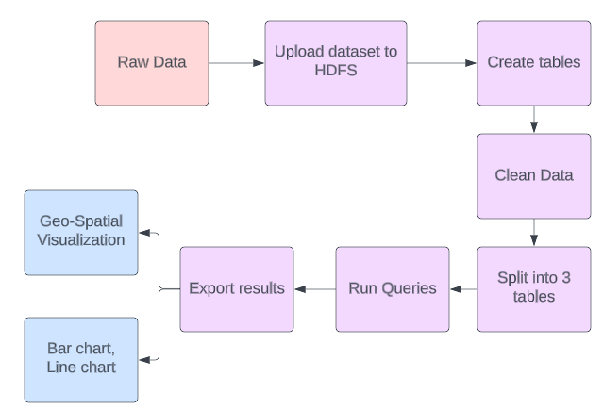

Flow Chart

Slide 8
Data Cleaning
We reformatted date from mm-dd-yyyy TO yyyy-mm-dd
TO_DATE(from_unixtime(unix_timestamp(issue_date, 'mm/dd/yyyy'), 'yyyy-mm-dd')) AS issue_date
Used CONCAT to put together an address
EX. CONCAT_WS(' ', house_number, street_name) AS address
Split the data into 3 tables:
Violation Data
Vehicle Data
Location

Slide 9



Queries
Total Tickets for each County using COUNT()
Bronx
Queens
Kings
Code: SELECT COUNT(*) AS total_tickets FROM ViolationData2017_BX2;
Code: SELECT COUNT(*) AS total_tickets FROM ViolationData2017_Q2;
Code: SELECT COUNT(*) AS total_tickets FROM ViolationData2017_K2;

Slide 10
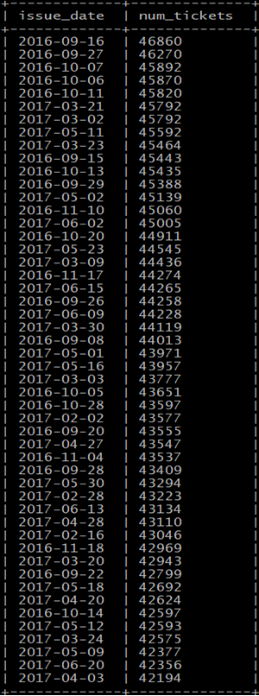
Queries in Beeline
Top 50 most ticketed days in 2017
Code:
SELECT issue_date, COUNT(*) as num_tickets
FROM ViolationData2017
WHERE issue_date IS NOT NULL
GROUP BY issue_date
ORDER BY num_tickets DESC
LIMIT 50;

Slide 11
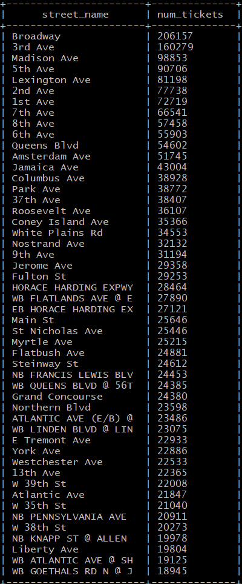
Queries in Beeline
What are the top 50 streets that receive the most tickets?
Code:
SELECT street_name, COUNT(*) as num_tickets
FROM LocationData2017
WHERE street_name IS NOT NULL
GROUP BY street_name
ORDER BY num_tickets DESC
LIMIT 50;

Slide 12
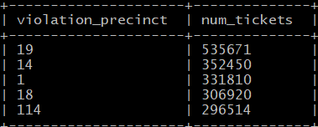
Queries in Beeline
Find the top 5 precincts that issued the most tickets in 2017
Code:
SELECT violation_precinct, COUNT(*) as num_tickets
FROM ViolationData2017
WHERE violation_precinct IS NOT NULL AND violation_precinct != 0
GROUP BY violation_precinct
ORDER BY num_tickets DESC
LIMIT 5;

Slide 13
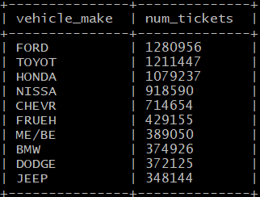
Queries in Beeline
Find the top 10 vehicles makes that received the most tickets in 2017
Code:
SELECT vehicle_make, COUNT(*) as num_tickets
FROM VehicleData2017
WHERE vehicle_make REGEXP '^[^0-9]+$' AND vehicle_make IS NOT NULL
GROUP BY vehicle_make
ORDER BY num_tickets DESC
LIMIT 10;

Slide 14
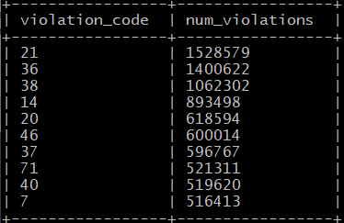
Queries in Beeline
Find the top 10 violation codes
Code:
SELECT violation_code, COUNT(*) as num_violations
FROM ViolationData2017
WHERE violation_code IS NOT NULL
GROUP BY violation_code
ORDER BY num_violations DESC
LIMIT 10;

Slide 15
Cont.
21. NO PARKING-STREET CLEANING
36. PHOTO SCHOOL ZONE SPEED VIOLATION
38. FAIL TO DISPLAY MUNI METER RECEIPT
14. NO STANDING-DAY/TIME LIMITS
20. NO STANDING-BUS STOP
46. DOUBLE PARKING
37. PHTO SCHOOL ZN SPEED VIOLATION
71. INSP. STICKER-EXPIRED/MISSING
40. FIRE HYDRANT
7. FAILURE TO STOP AT RED LIGHT

Slide 16
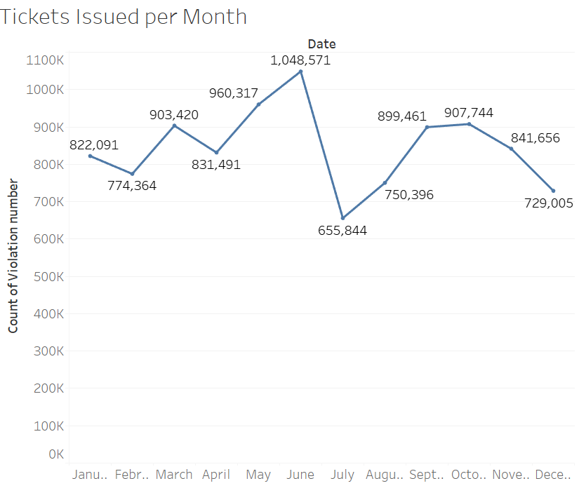
Visualizations

Slide 17
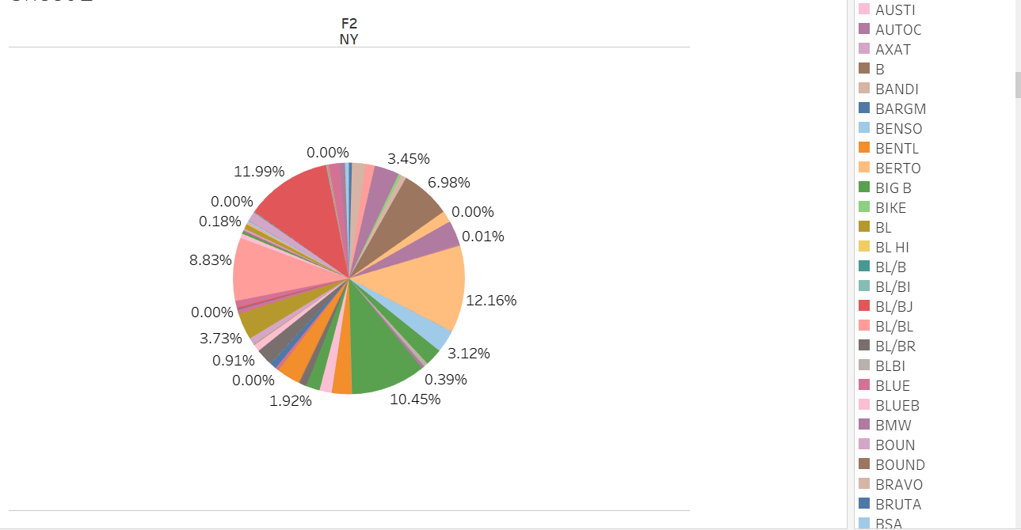
Visualization
Pie chart of all the Car Makes
Percentages
12.16% Ford
11.99% Toyota
10.45% Honda
8.83% Nissan
6.98% Chevrolet

Slide 18
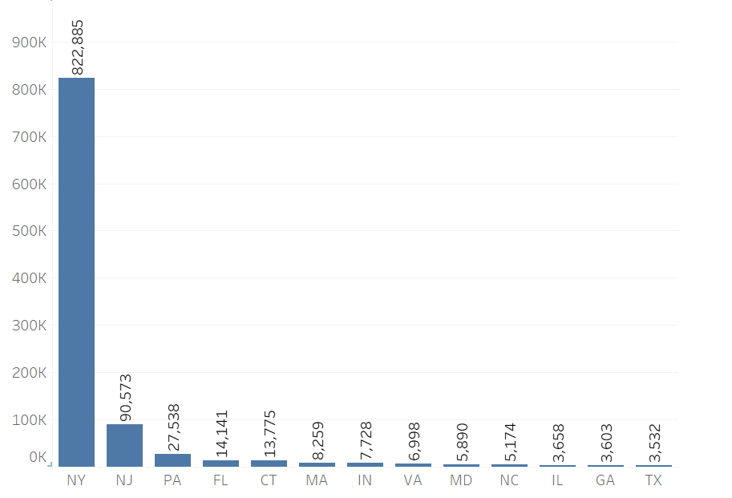
Visualization
Top Registration States
New York
New Jersey
Pennsylvania
Florida
Connecticut
Massachusetts
Indiana
Virginia
Maryland
North Carolina
Illinois
Georgia
Texas

Slide 19
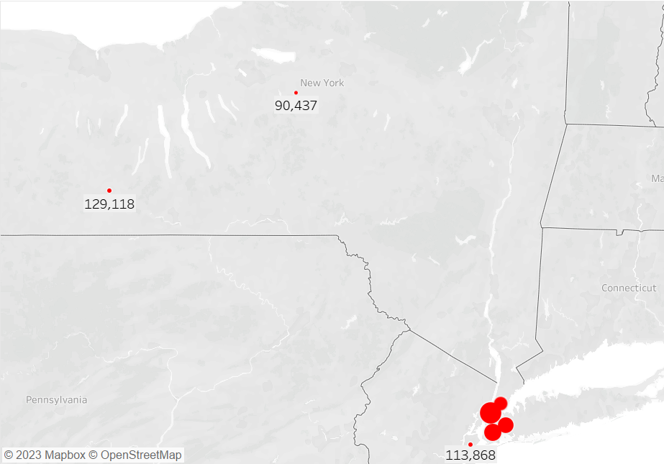
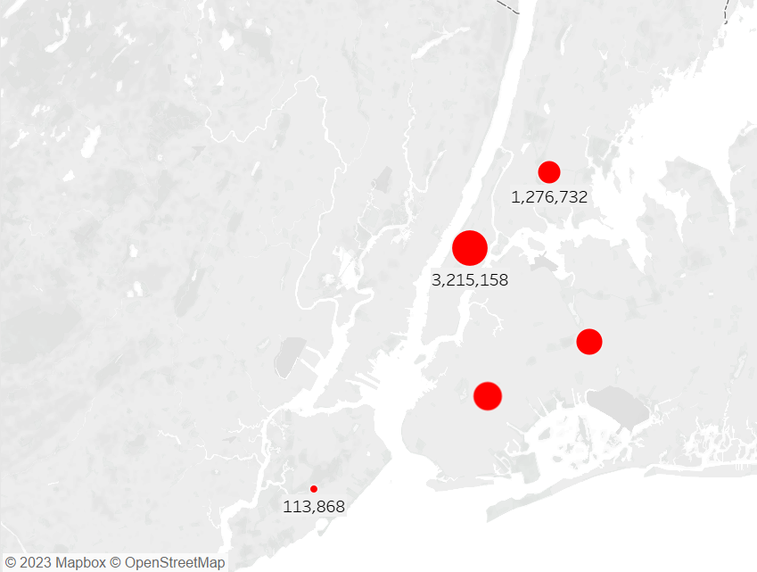
Geo-Spatial Visualization

Slide 20
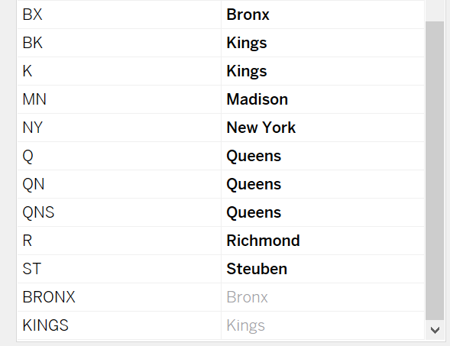
Geo-Spatial Visualization

Slide 21
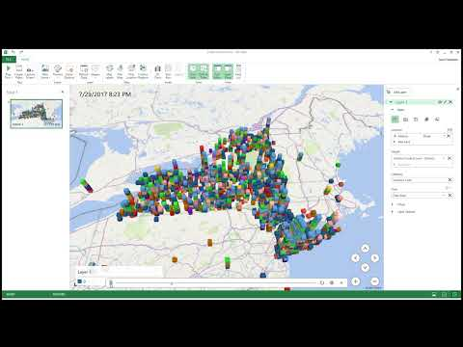
Kings New York Visualization

Slide 22
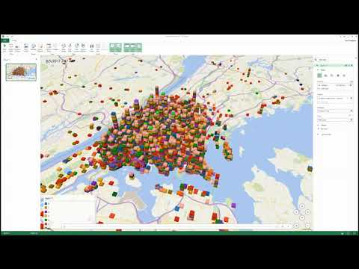
Bronx New York Visualization

Slide 23
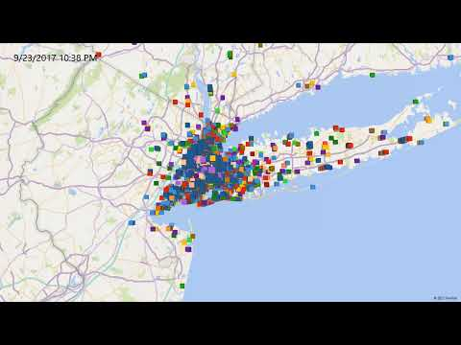
Queens New York Visualization

Slide 24
Findings
We found that in the month of April – June majority of the tickets occurred.
Also, found that besides most of the vehicles registered in NY had majority of the tickets, cars registered in NJ also had the second highest number of tickets. And Texas had the least.
Also found that almost 30% of cars that got tickets were imports like Toyota, Honda, and Nissan.
Majority of the tickets were from no – parking street cleaning.

Slide 25
References
Ackerman, Samuel S. Red Zone, Blue Zone: Discovering Parking Ticket Trends in New York City, newyorkparkingticket.com/wp-content/uploads/2016/11/NYC-Parking-Ticket-Report_parking_Samuel_Ackerman5.pdf. Accessed 8 May 2023.
Ginzburg, Steven. “Data Visualizing New York City’s Parking Violation.” Data Science Blog, 1 May 2016, nycdatascience.com/blog/student-works/data-visualizing-new-york-citys-parking-violation/.
York, City of New. “NYC Parking Tickets.” Kaggle, CITY OF NEW YORK, 10 May 2020, https://www.kaggle.com/datasets/new-york-city/nyc-parking-tickets.

